Slide 1
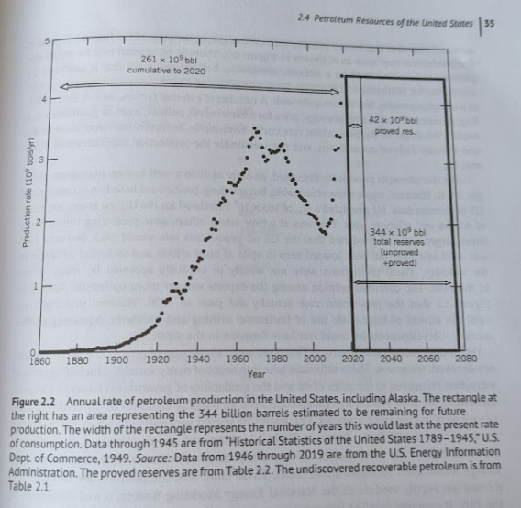
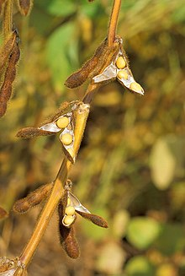
Crude Oil from Soybeans

Slide 2
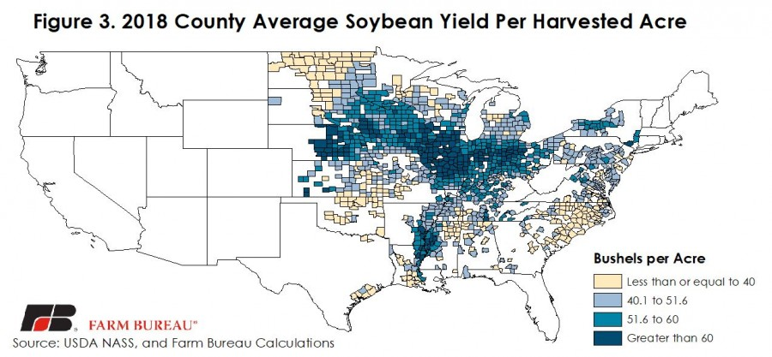







50bu per acre?
Notes:
https://www.fb.org/market-intel/reviewing-county-level-corn-and-soybean-yields-in-2018

Slide 3
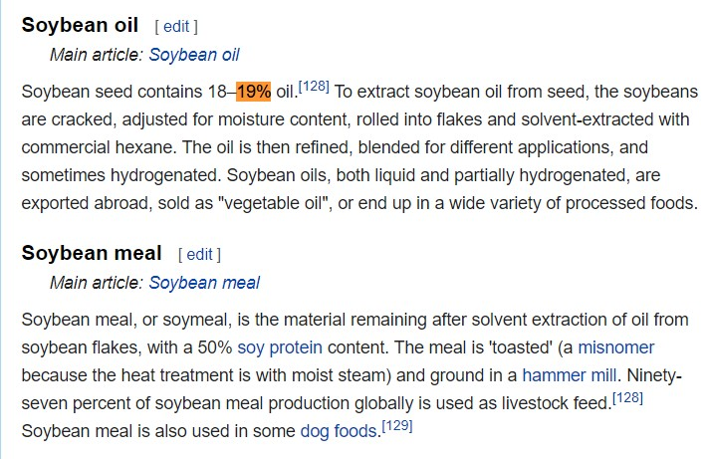

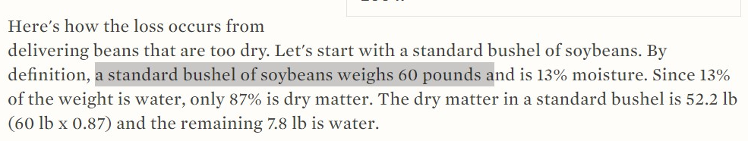
Start here 11-01
Notes:
https://en.wikipedia.org/wiki/Soybean https://cropwatch.unl.edu/harvest-soybeans-13-moisture

Slide 4

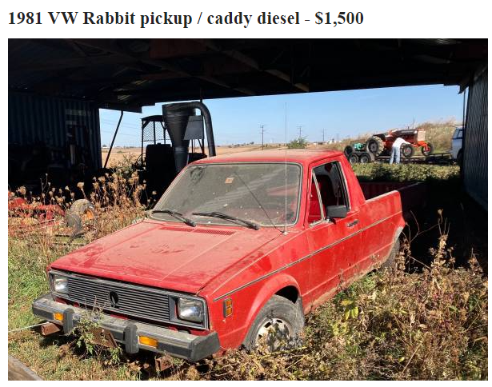
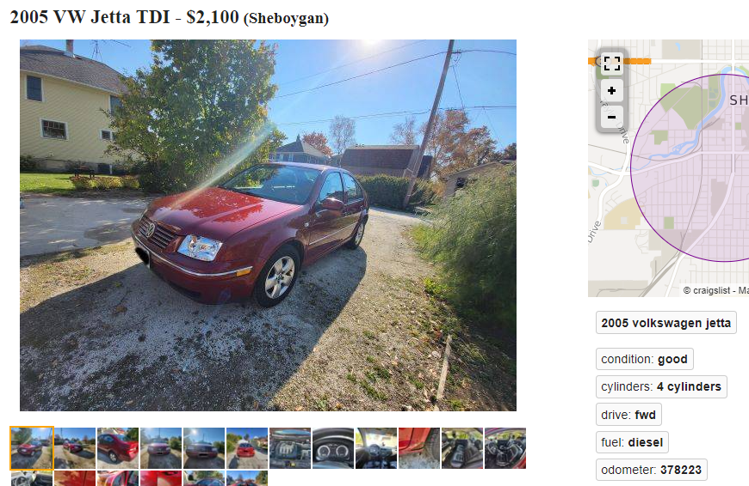



Why?

Slide 5
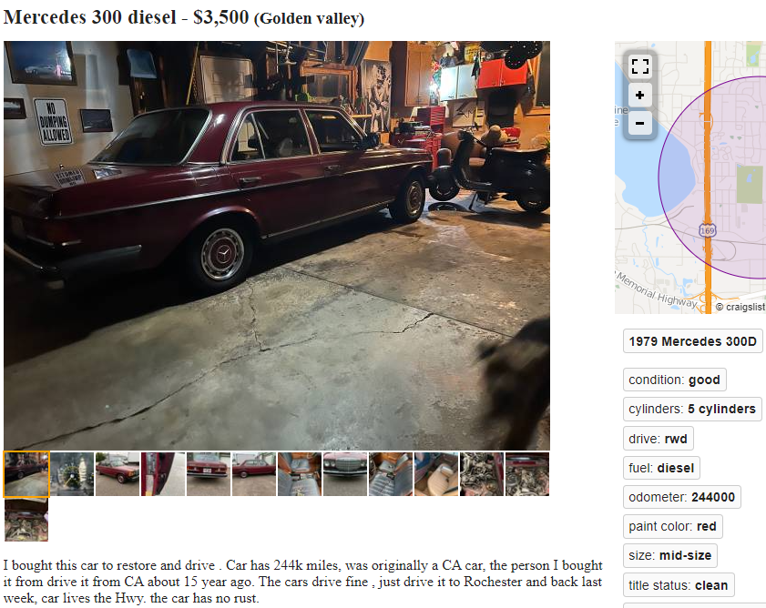



Slide 6
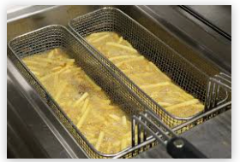
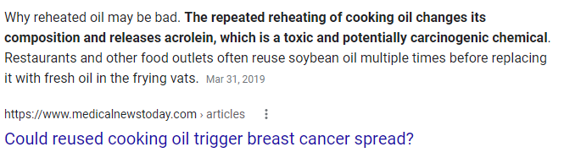
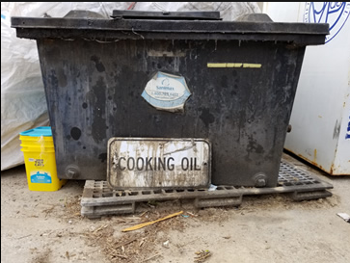
Free fuel?
Notes:
https://www.medicalnewstoday.com/articles/324806

Slide 7
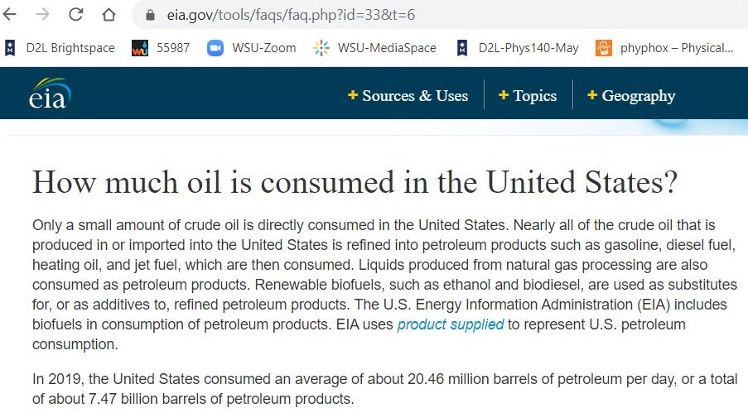
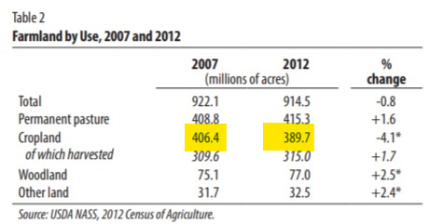






Notes:
https://www.nass.usda.gov/Publications/Highlights/2014/Highlights_Farms_and_Farmland.pdf
https://www.eia.gov/tools/faqs/faq.php?id=33&t=6

Slide 8







Slide 9
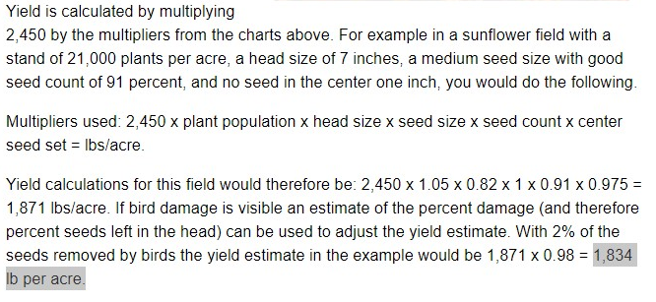
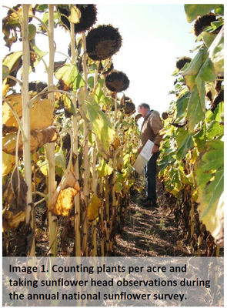
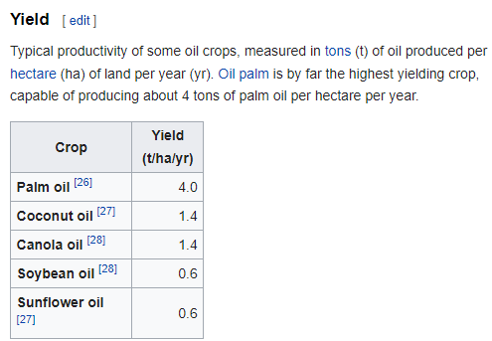

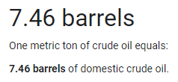
Notes:
https://en.wikipedia.org/wiki/Vegetable_oil#Yield
https://www.ipaa.org/reference-tools/
https://farm-energy.extension.org/sunflowers-for-biofuel-production/
https://www.ag.ndsu.edu/cpr/plant-science/estimating-sunflower-yield-8-16-12

Slide 10





https://en.wikipedia.org/wiki/Vegetable_oil#Yield
Notes:
1 ton oil/ha ~= 3 bbu/acre

Slide 11


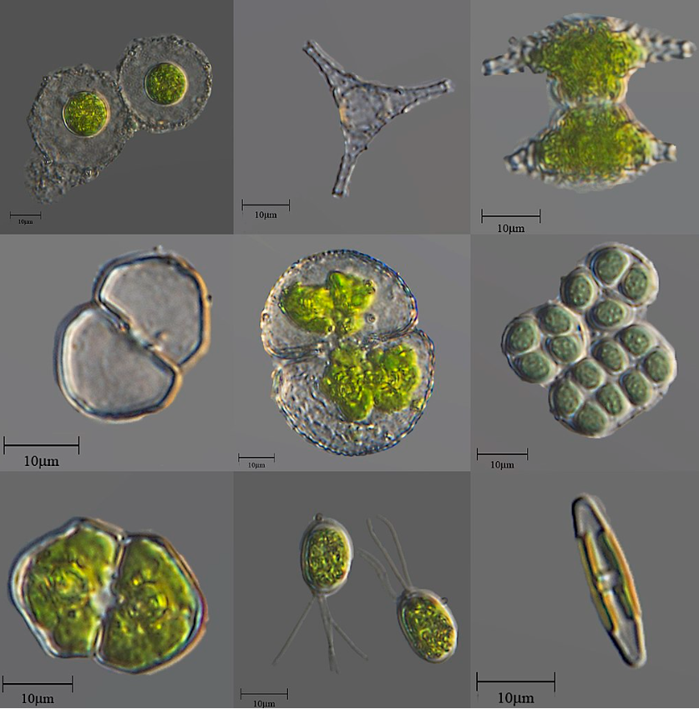
Notes:
https://en.wikipedia.org/wiki/Sunflower_seed

Slide 12
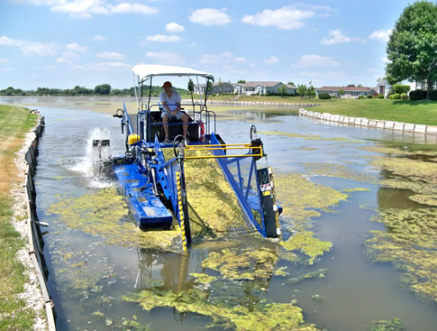

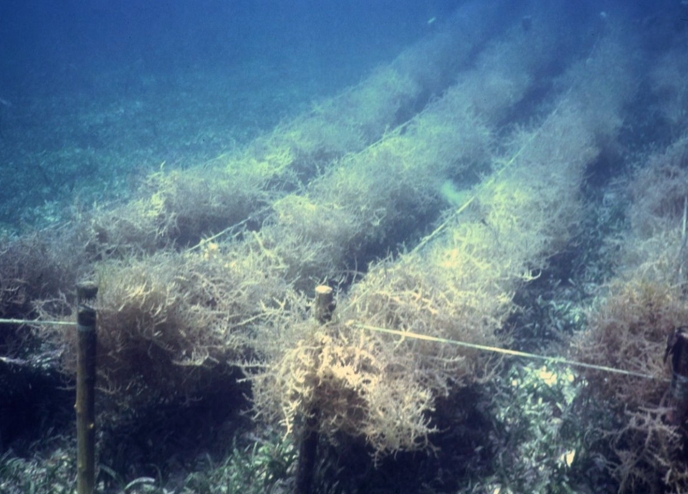
Notes:
https://en.wikipedia.org/wiki/Algae

Slide 13
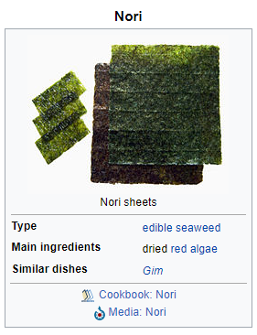

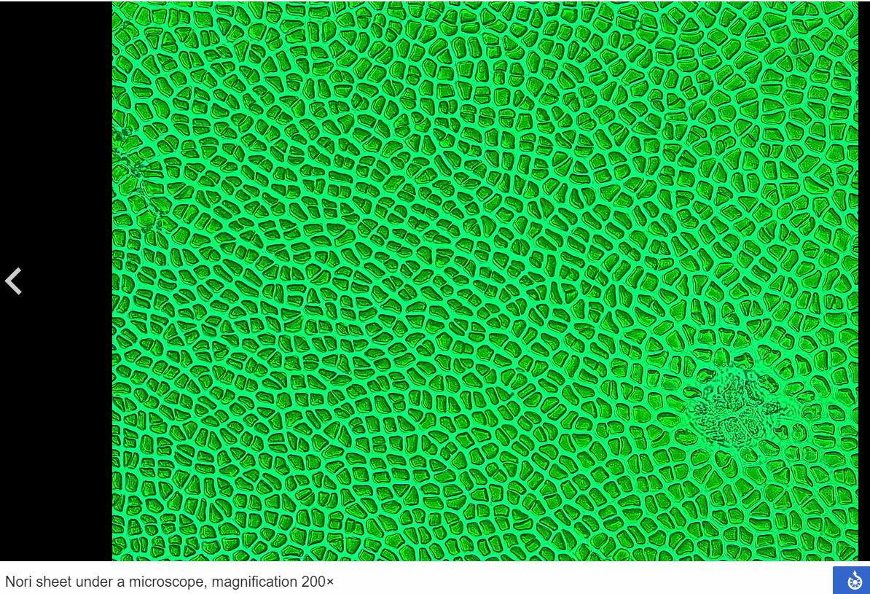
Notes:
https://en.wikipedia.org/wiki/Nori

Slide 14
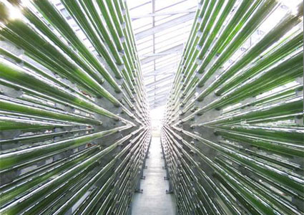
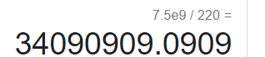


Algae! 90 000 L/ha = 220 bbu/acre if US needs 7.5 billion bbu of oil…
https://microbewiki.kenyon.edu/index.php/Biodiesel_from_Algae_Oil​
Notes:
https://microbewiki.kenyon.edu/index.php/Biodiesel_from_Algae_Oil

Slide 15
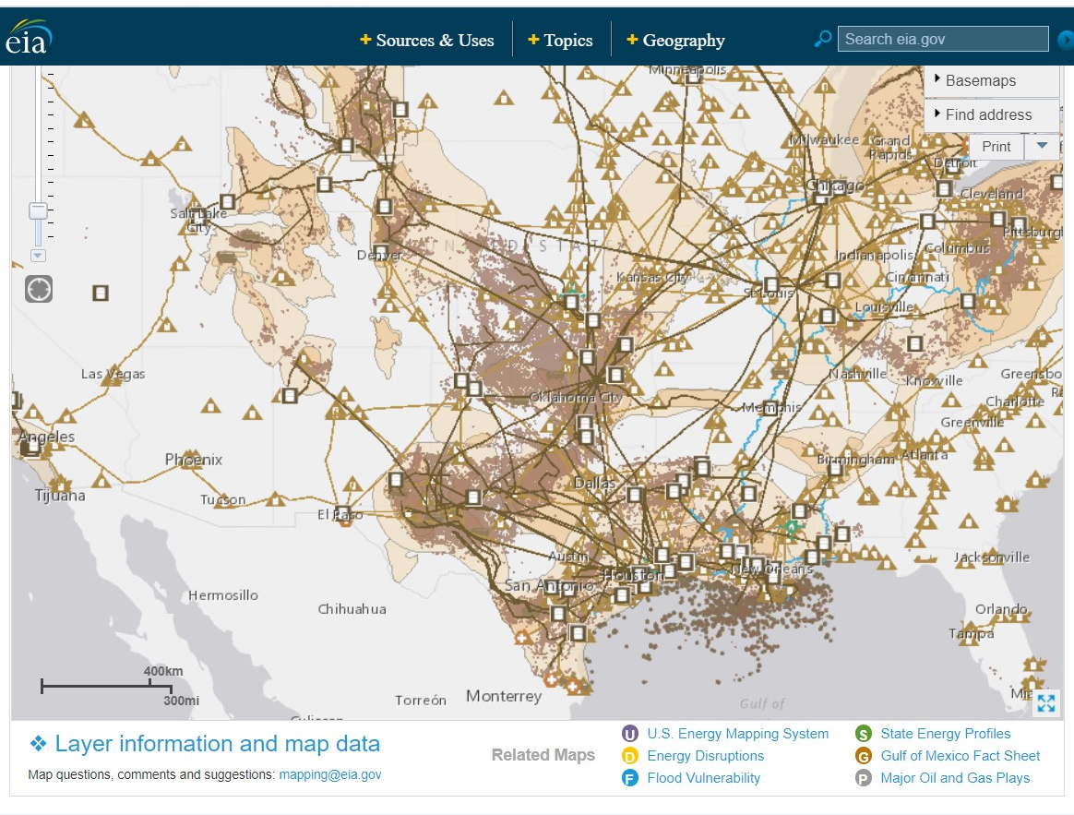
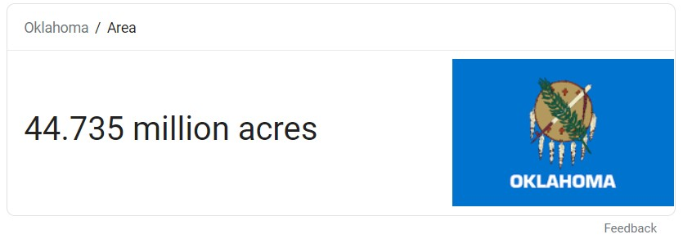
Only 33M acres of algae-oil farms to produce ALL of US Oil demand.
Oklahoma and Texas should grow crude oil via algae.
They’re already the national hub of petroleum processing
For more, see https://www.energy.gov/eere/videos/energy-101-algae-fuel

Slide 16
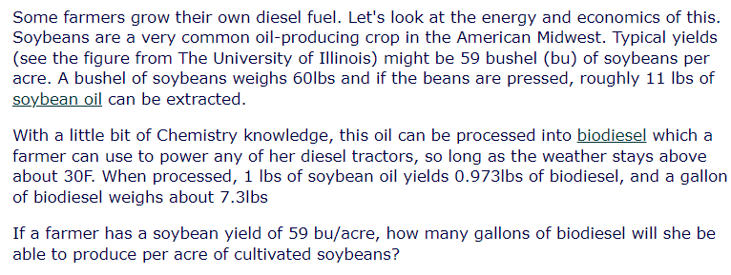


















Slide 17
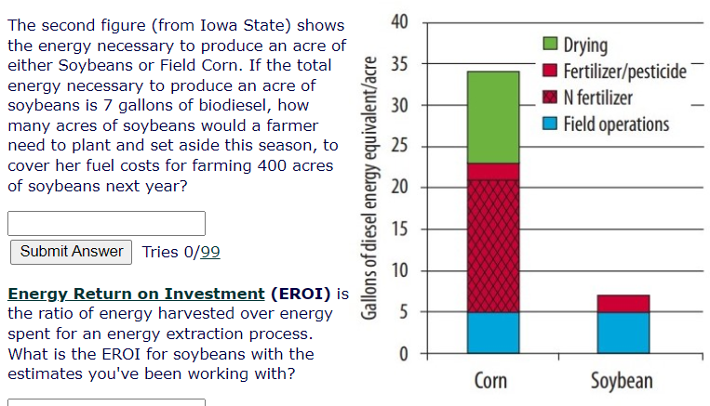












Slide 18

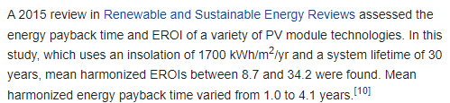
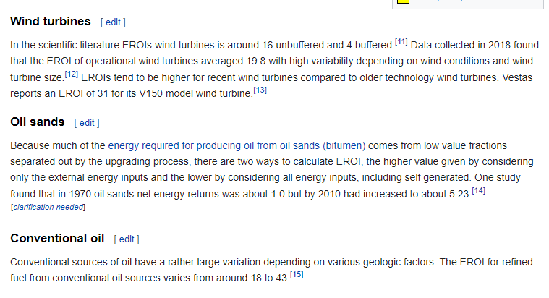
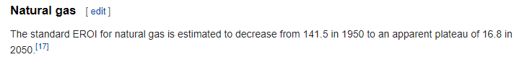








Notes:
https://en.wikipedia.org/wiki/Energy_return_on_investment

Slide 19
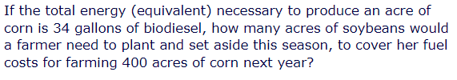










Slide 20
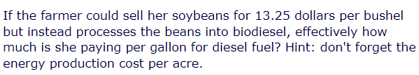
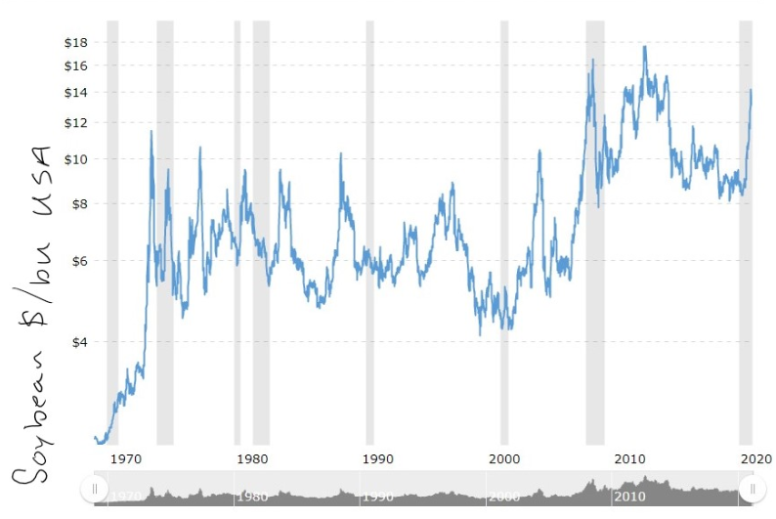


















Slide 21
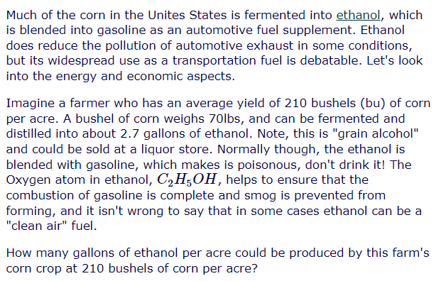
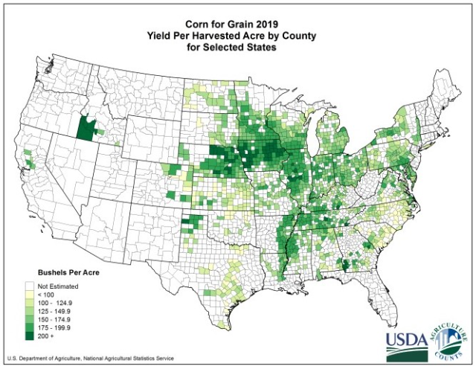






Slide 22
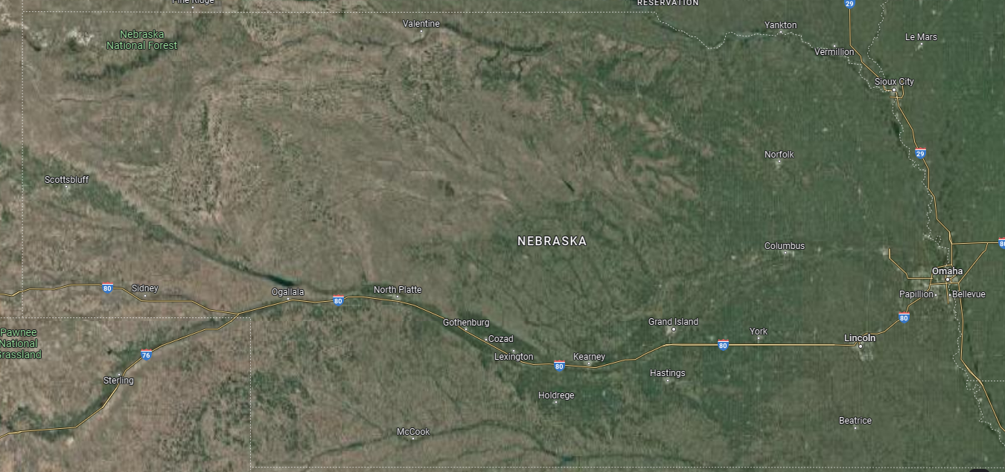
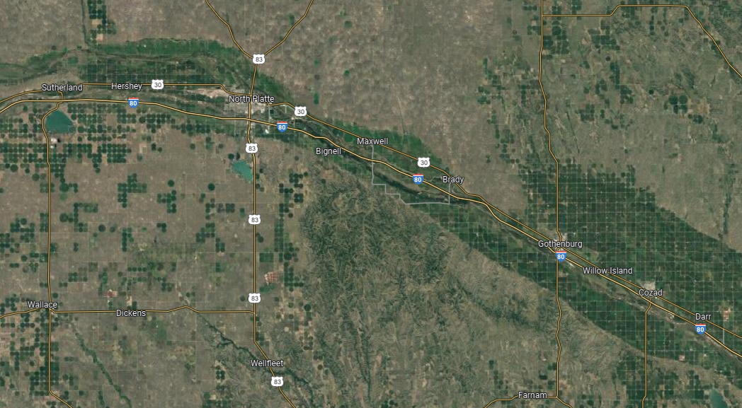


Slide 23
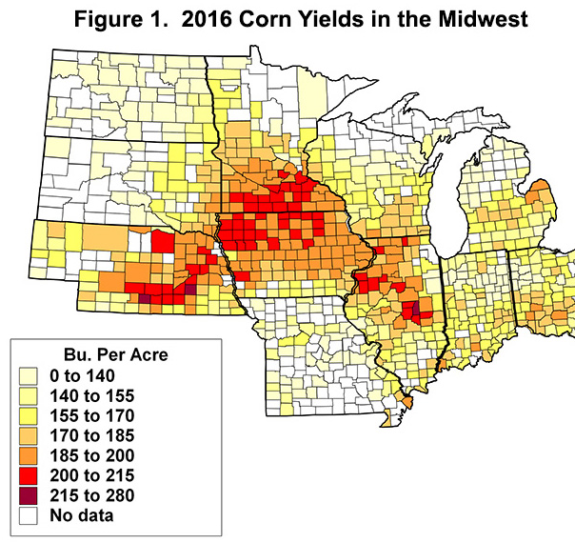
Notes:
https://farmdocdaily.illinois.edu/2016/03/county-corn-soybean-yields-2015.html

Slide 24



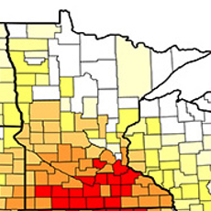


$100- 500k
$500k
Notes:
https://www.machinerypete.com/blogs/how-much-does-a-case-ih-combine-cost
https://machinerylink.com/tractors/john-deere-9rt-590-specifications/

Slide 25
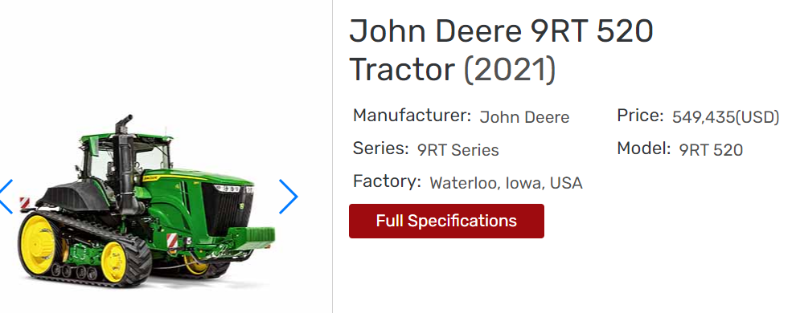

Slide 26
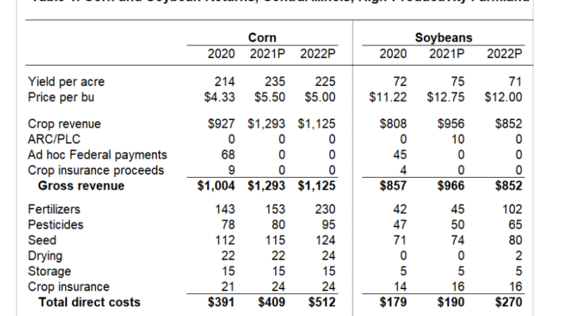
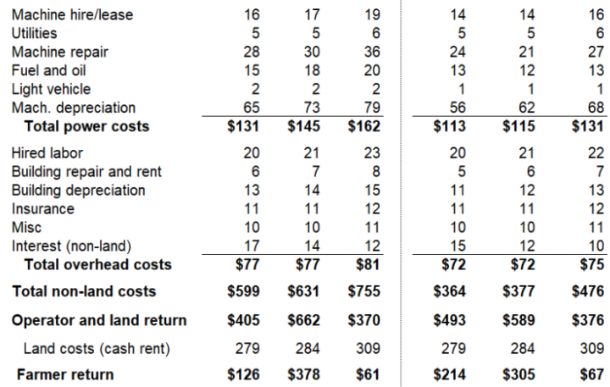
2020 Corn (per acre):
$1004/acre GROSS income
$126/acre NET income
Notes:
https://farmdocdaily.illinois.edu/2021/12/2022-updated-crop-budgets.html

Slide 27
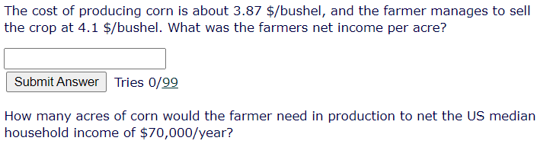



Slide 28
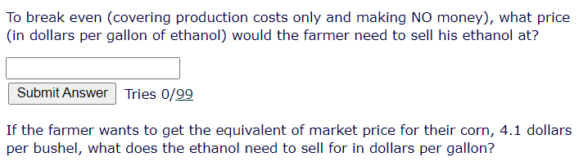







Slide 29
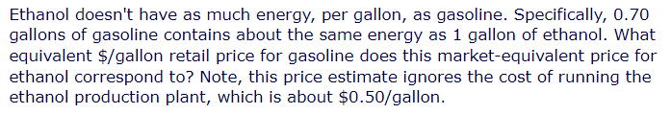
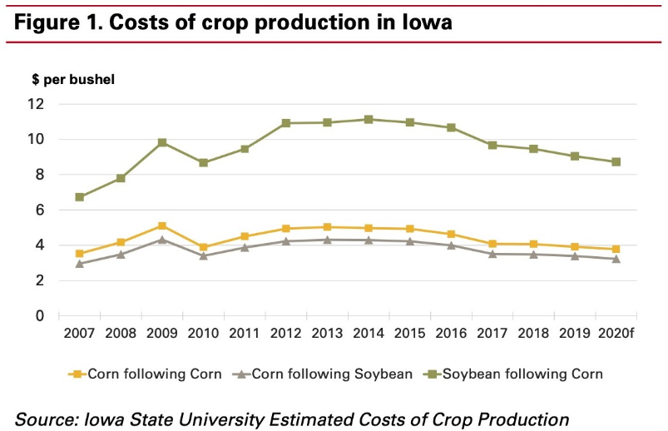




Slide 30
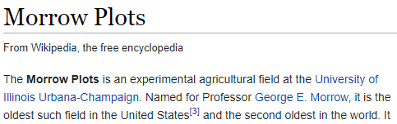
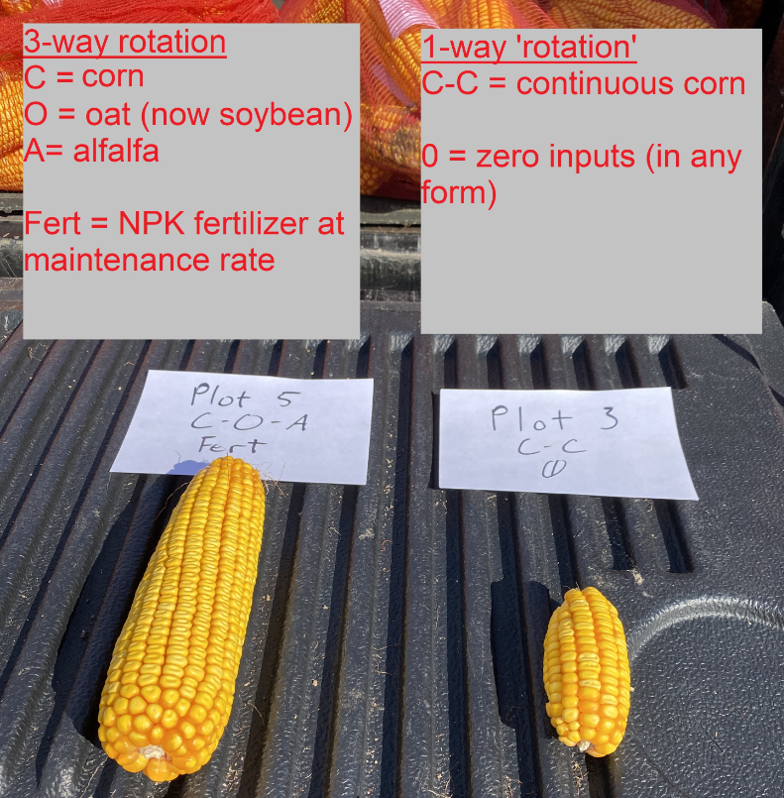

Since 1876!
Notes:
https://en.wikipedia.org/wiki/Morrow_Plots
https://aces.illinois.edu/research/history/morrow-plots
https://slideplayer.com/slide/7043035/
https://twitter.com/ajmargenot/status/1441825091944259594

